Slide 1




NEXT GEN EMPLOYABILITY PROGRAM
Creating a future-ready workforce
Team Members
College Name
Student Name :Sreeja S
Student ID :
Stella Mary’s college of Engineering

Slide 2

CAPSTONE PROJECT SHOWCASE
Project Title
Car Rentals Application with Django Framework
Abstract | Problem Statement | Project Overview | Proposed Solution | Technology Used | Modelling & Results | Conclusion

Slide 3
Abstract
The car rental industry has seen significant growth over the past decade, driven by the increasing popularity of travel, tourism, and urbanization. A car rental website serves as a crucial platform connecting customers with rental car providers, offering convenience, choice, and flexibility in vehicle selection and booking processes.
Source :

Slide 4
Problem Statement
Limited Options:
Without a car rental website, individuals may have limited options for renting vehicles. They may need to rely on local rental agencies, which may have a smaller fleet or offer fewer choices in terms of vehicle types, makes, and models.
Lack of Convenience:
Booking a rental car without a dedicated website can be less convenient and time-consuming. Individuals may need to visit or call multiple rental agencies to compare prices, check availability, and make reservations, resulting in added effort and potential frustration.
Higher Costs:
In the absence of online price comparisons and booking discounts available on car rental websites, individuals may end up paying higher rental rates or missing out on cost-saving opportunities. They may also incur additional expenses, such as transportation to rental agencies or agent booking fees.
Source :

Slide 5
Project Overview
Introduction:
The car rental website project aims to develop an online platform that facilitates the rental of vehicles to individuals and businesses. This platform will provide a user-friendly interface for customers to browse available vehicles, make reservations, and manage bookings. The project will involve designing and implementing features such as vehicle listings, booking management, user authentication, payment processing, and administrative tools for rental agencies.
Objectives:
Create a comprehensive database of vehicles available for rent, including various makes, models, and types (e.g., sedans, SUVs, vans).
Develop a user-friendly website interface that allows customers to search, compare, and book rental vehicles based on their preferences and requirements.
Implement secure user authentication mechanisms to enable customers to create accounts, manage profiles, and access booking history.
Source :

Slide 6
Proposed Solution
.
Project Setup and Environment Configuration:
Set up a Django project environment with virtual environment isolation.
Install necessary packages and dependencies using pip, including Django, MySQL (or another suitable database)
Configure project settings, including database connection, static files, media files.
Database Design and Models:
Define Django models to represent entities such as vehicles, rental agencies, users, bookings, and transactions.
Source :

Slide 7
Frontend Development:
Design user interfaces using HTML templates with Django template language for dynamic content rendering.
Utilize frontend frameworks like Bootstrap or Materialize CSS for responsive design and styling.
Implement JavaScript functionalities for interactive features such as form validation, search filtering, and dynamic content loading.
Vehicle Listings and Search Functionality:
Develop views and templates for displaying lists of available vehicles, including search filters and sorting options.
Implement search functionality based on criteria such as location, dates, vehicle type, and features.
Integrate mapping APIs like Google Maps or Mapbox to display rental agency locations and provide route planning options.
Source :

Slide 8
Booking Management System:
Create views and forms for users to browse vehicle availability, select rental dates, and make reservations.
Implement backend logic to handle booking requests, check availability, calculate rental rates, and generate booking confirmations.
Utilize Django's built-in form validation and error handling mechanisms to ensure data integrity and prevent booking conflicts.
Admin Dashboard and Management Tools:
Create administrative views and interfaces for managing vehicle inventory, rental bookings, user accounts, and transactions.
Implement CRUD (Create, Read, Update, Delete) operations for administrative tasks, with appropriate permissions and access controls.
Utilize Django's admin interface or custom-built dashboards with enhanced functionality for rental agency staff and administrators.
Source :

Slide 9


Technology Used
Front-end
Back-end
Source :

Slide 10
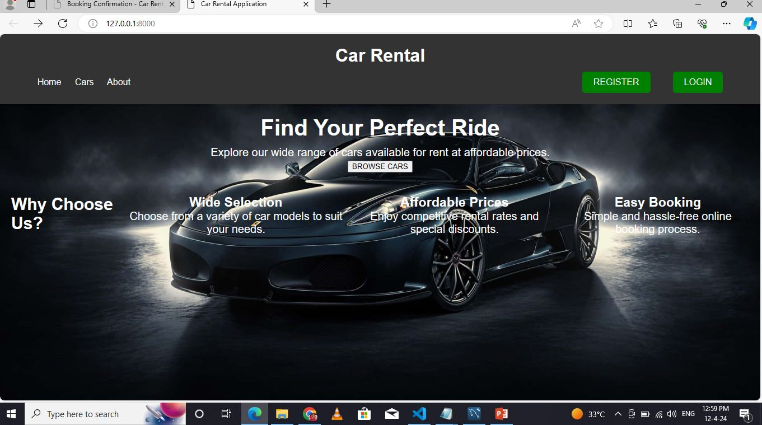
Homepage
Source :

Slide 11
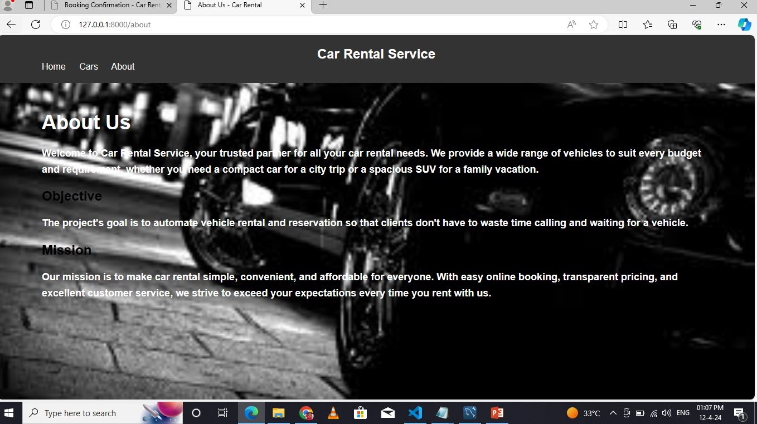
About Us

Slide 12
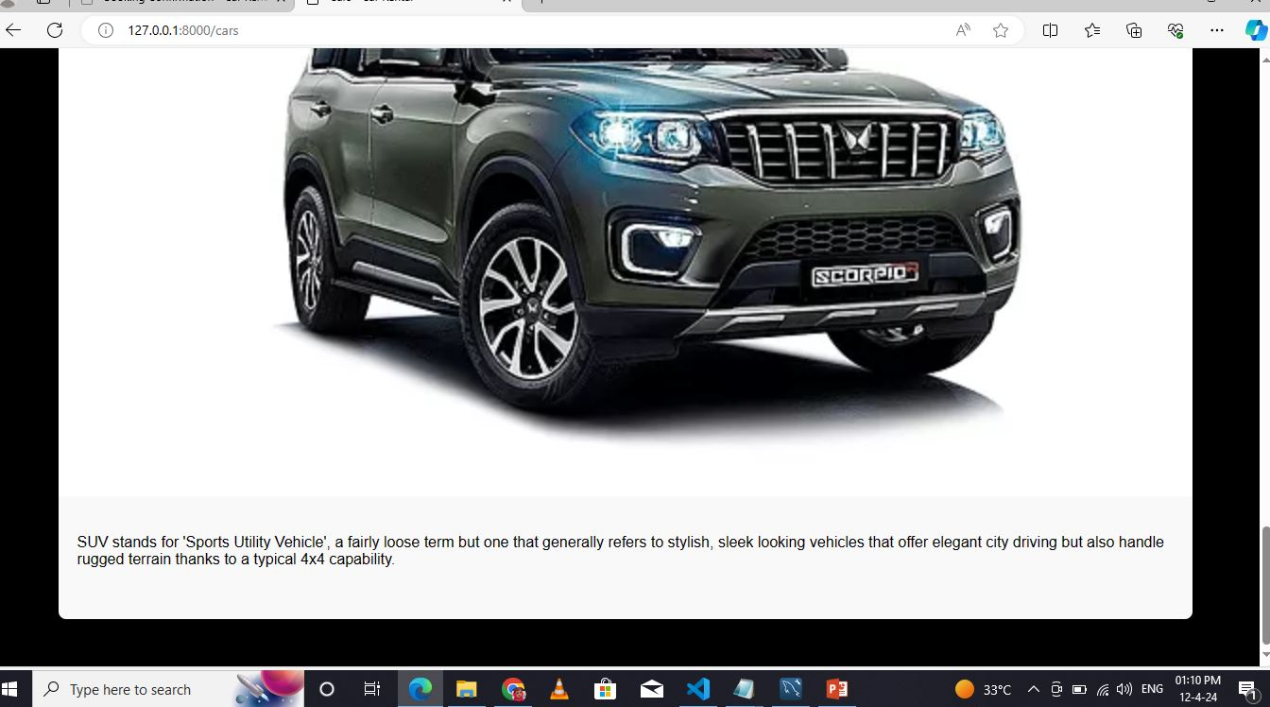
Cars

Slide 13
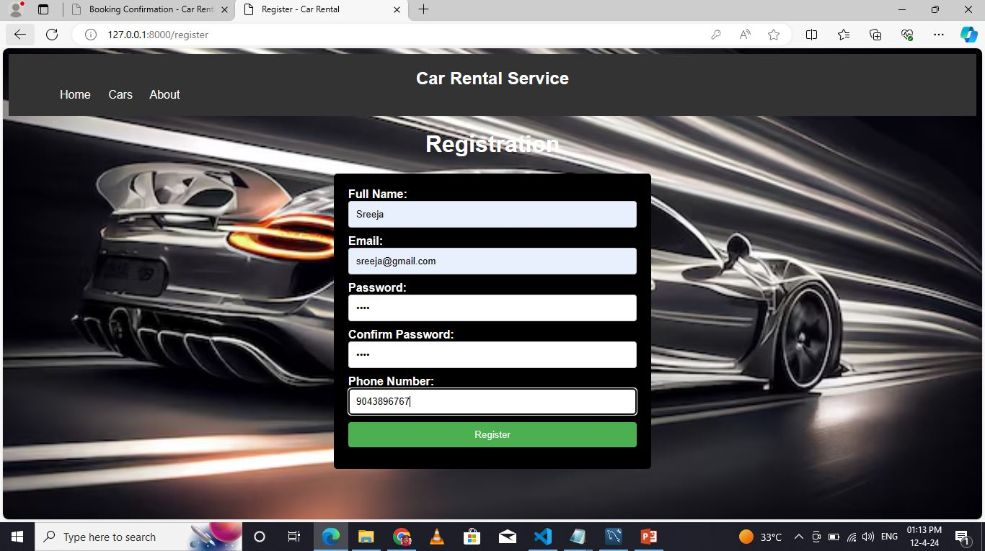
Registration

Slide 14
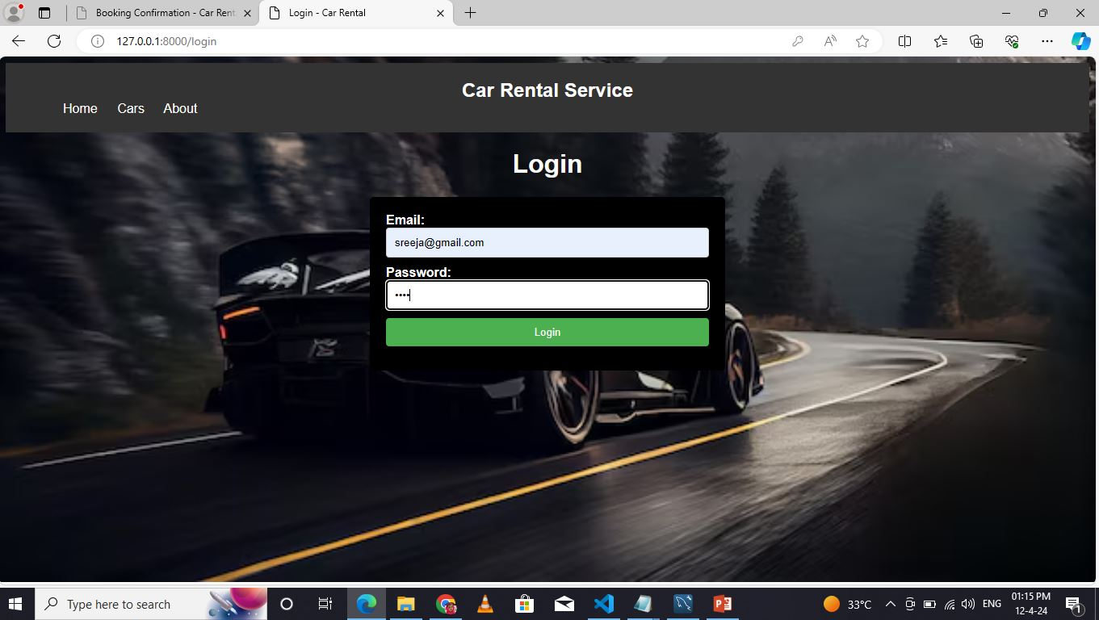
Login

Slide 15
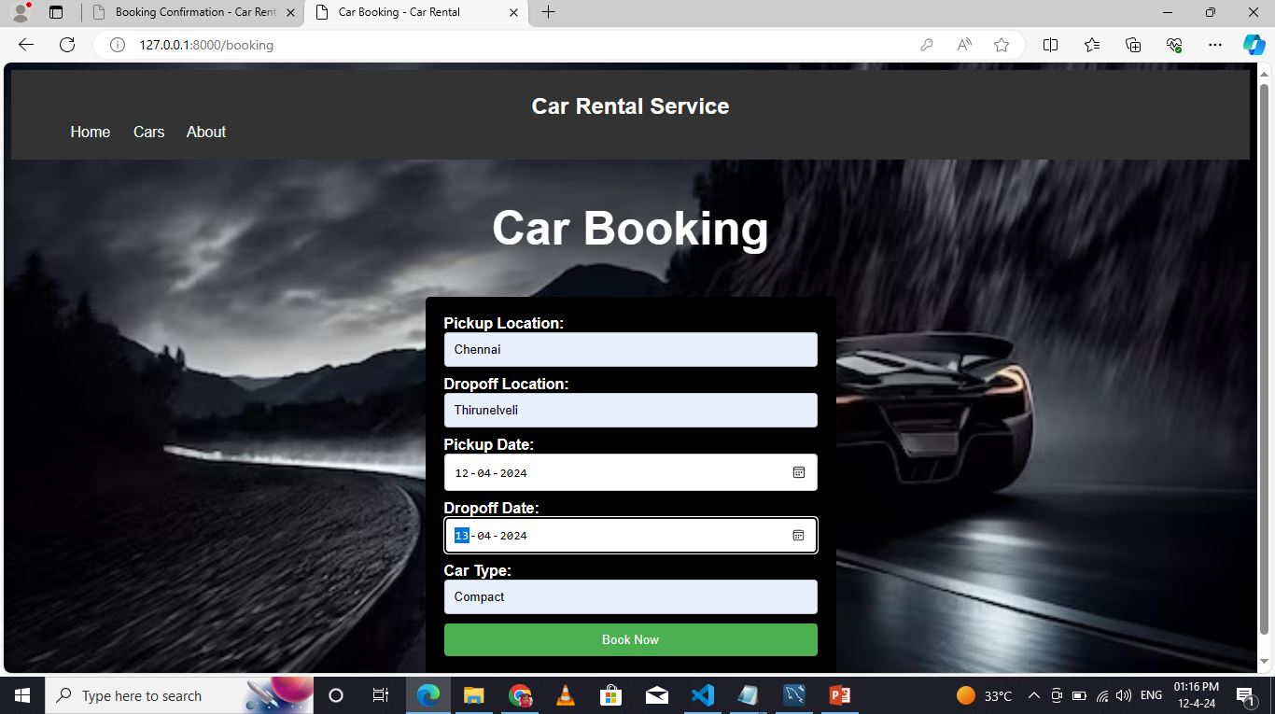
Booking

Slide 16
Future Enhancements:
User Reviews and Ratings:
Allow users to leave reviews and ratings for rental vehicles and rental agencies. Implement a rating system to help future renters make informed decisions and improve transparency
Integration with Car Tracking Systems:
Integrate with car tracking systems to provide real-time vehicle location and status updates. This feature can help users locate their rental vehicles, track mileage, and ensure vehicle security.
Flexible Booking Options:
Allow users to modify or cancel bookings online, subject to terms and conditions. Implement flexible booking options such as hourly rentals, one-way rentals, and long-term leases to accommodate diverse customer needs.
Multi-Language Support:
Provide support for multiple languages to cater to a global audience. Implement localization features to translate the website content, interface elements, and booking process into different languages.

Slide 17
Conclusion
Enhanced User Experience:
The car rental website project aims to provide a seamless and intuitive user experience, making it easy for customers to find and book rental vehicles online.
Improved Transparency and Trust:
Features such as user reviews and ratings, transparent pricing, and detailed vehicle information enhance transparency and build trust with customers.
Efficient Management Tools:
For rental agencies, the website provides efficient management tools and administrative dashboards for tracking bookings, managing inventory, and analyzing performance metrics.
Mobile Compatibility:
With mobile-responsive design and native app integration, the website ensures accessibility and convenience for users on smartphones and tablets, enhancing the overall user experience.
Source :

Slide 18
Thank You!
Notes:
Thank You !!

